Slide 1

Arab Academy for Science &Technology & Maritime Transport College of Artificial Intelligence, El Alamein Data Science Department GN341 Mobile Computing
Lecturer: Prof. Ossama Mohamed Badawy
Eng: Rawan Mohamed. Saad Zaghloul
Name: Mahmoud Abouzeid Mohamed & Hamzah Fawzy .
Reg_num: 211002338 & 211000489.

Slide 2
OUTLINES
Project Introduction
How it Works
Model Performance
UI Design
App Development
Testing
Deployment
Analysis
Conclusion
References

Slide 3
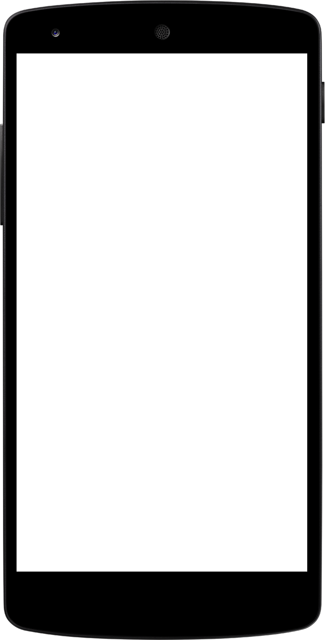
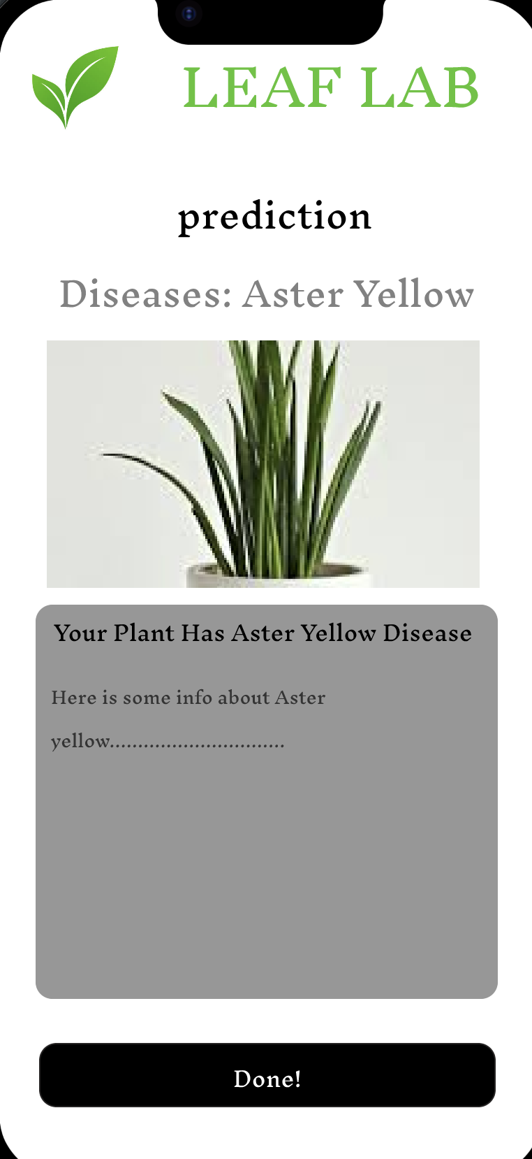
LEAF LAB
LeafLab is an application that helps users to identify diseases in plants. It uses Deep Learning techniques (AI) to perform this. The user takes a photo of the leaf/ plant and a page for will pop up classifying the disease. Users may also access the gallery to use an existing photo and the app will predict what disease it is affected with.

Slide 4
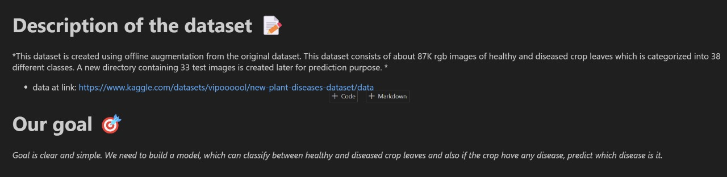
HOW IT WORKS
First we found the correct dataset to be able to train the data to be able to create a model to predict the disease that has affected the leaf

Slide 5
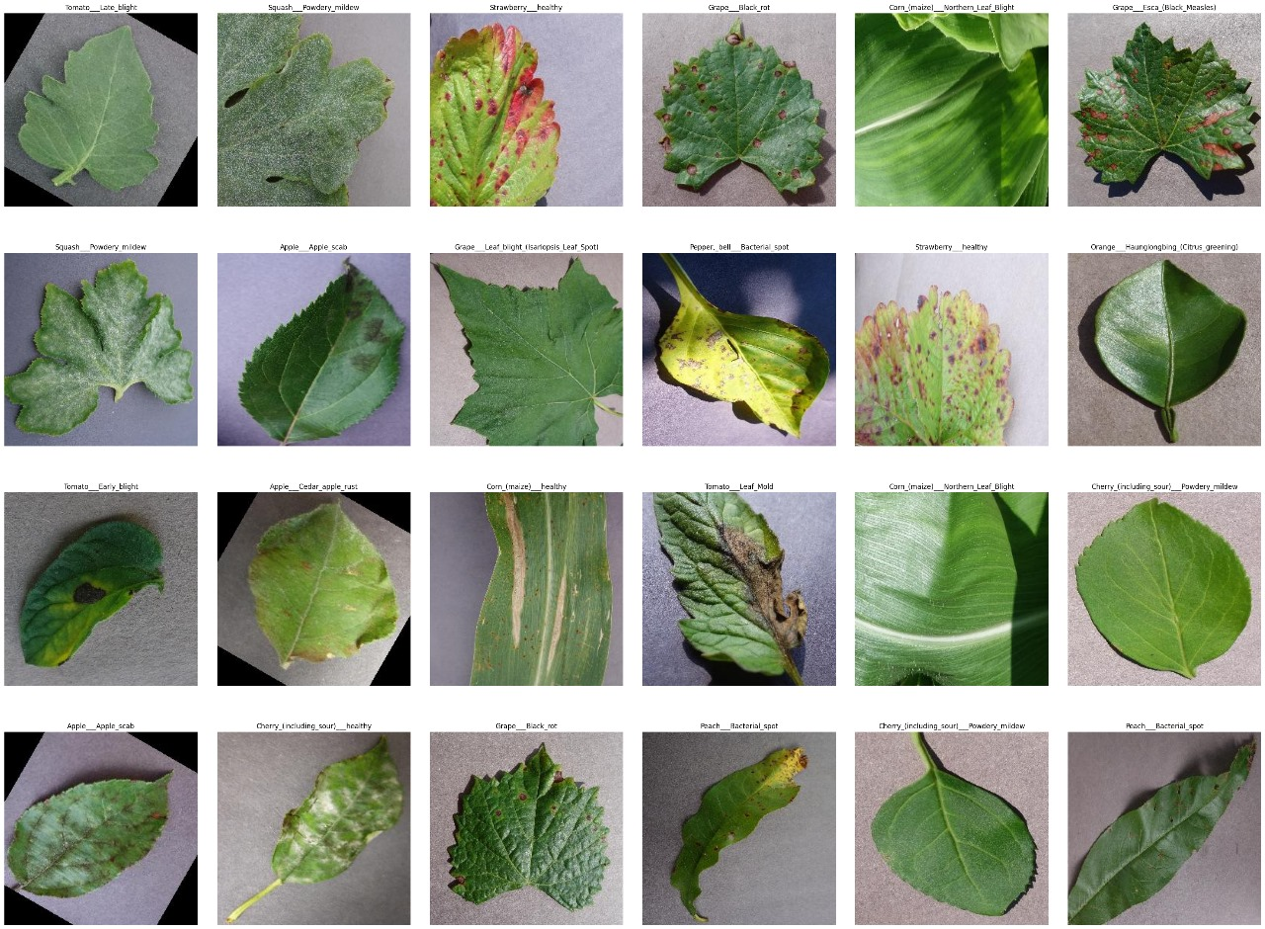

Slide 6
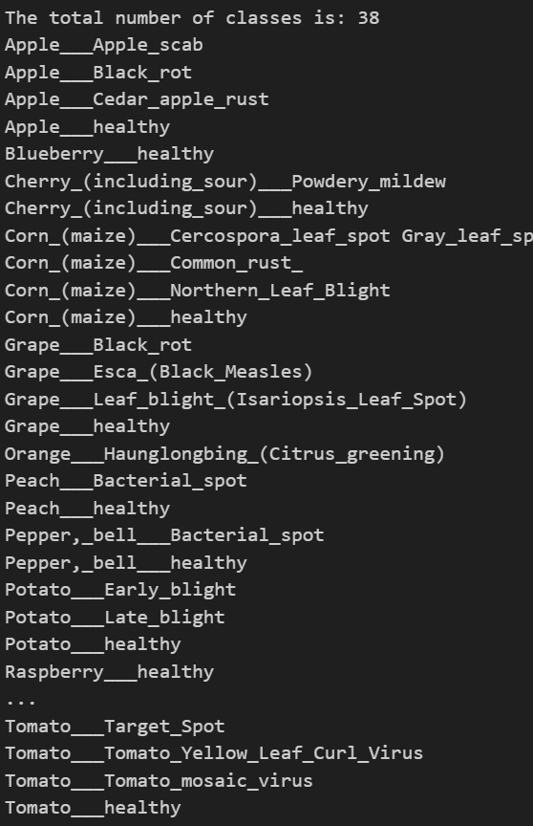
CLASSES
WE HAD A TOTAL OF 38 CLASSES MEANING THERE ARE 38 DISEASES THAT CAN AFFECT THE PLANT

Slide 7
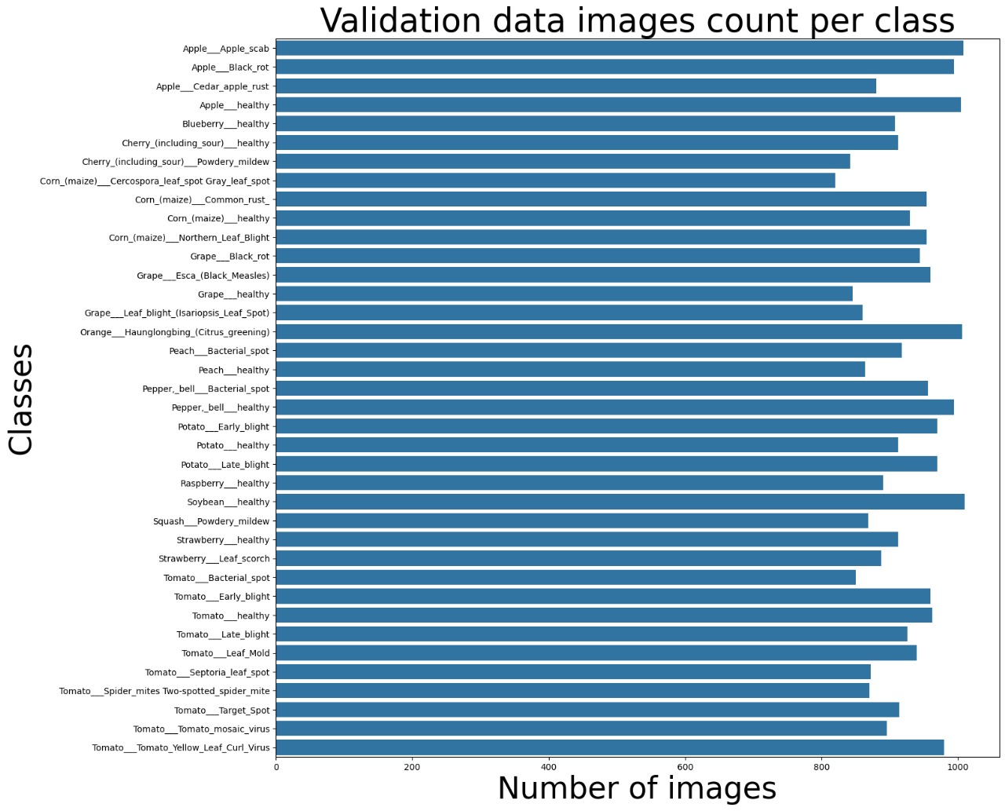

Slide 8
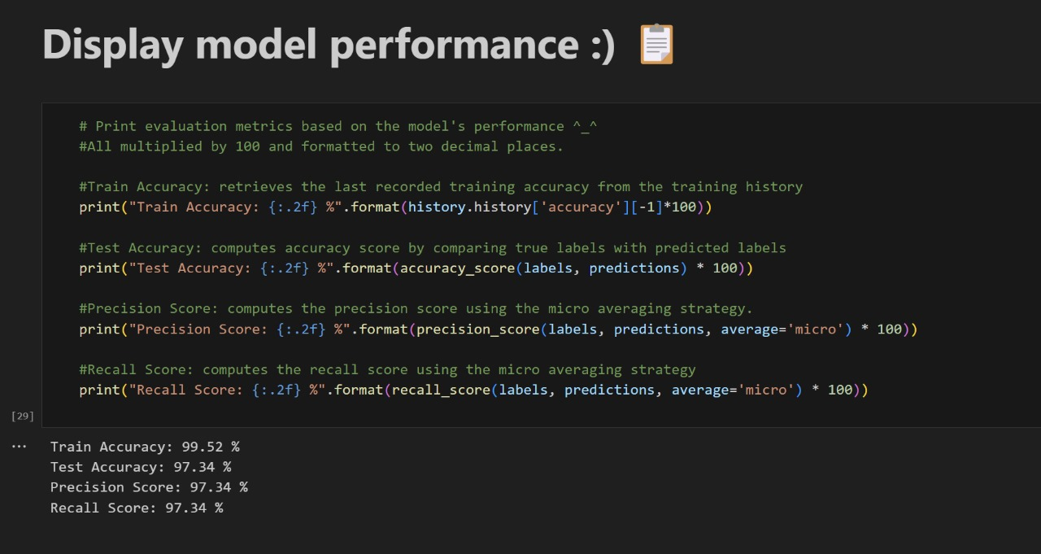
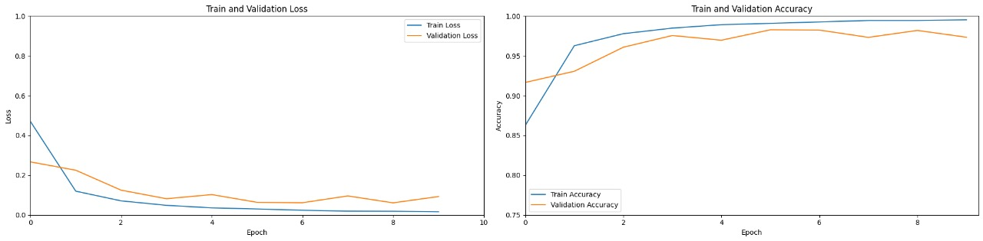
MODEL PERFORMANCE
After building the model we then analysed to make sure it gives us the best accuracy it can

Slide 9
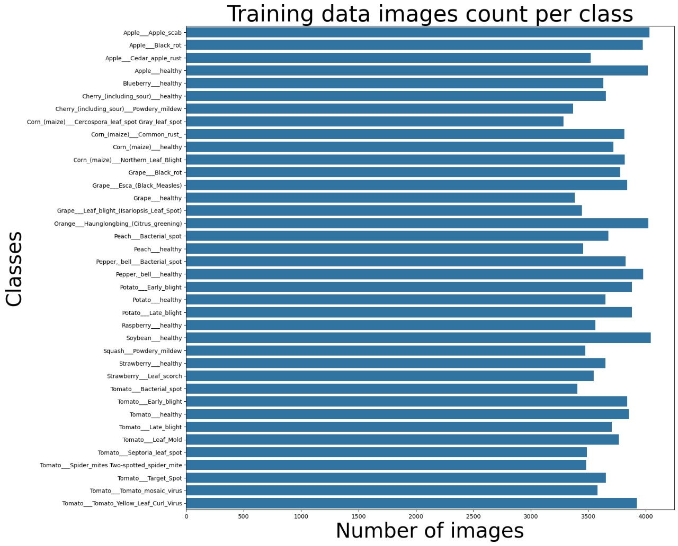

Slide 10
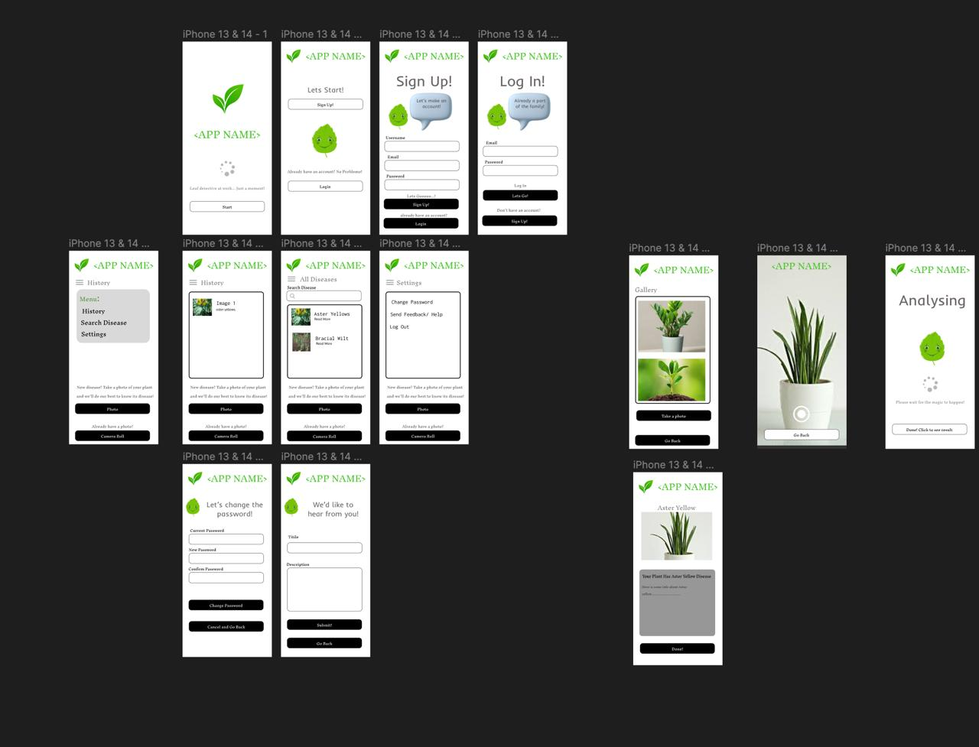
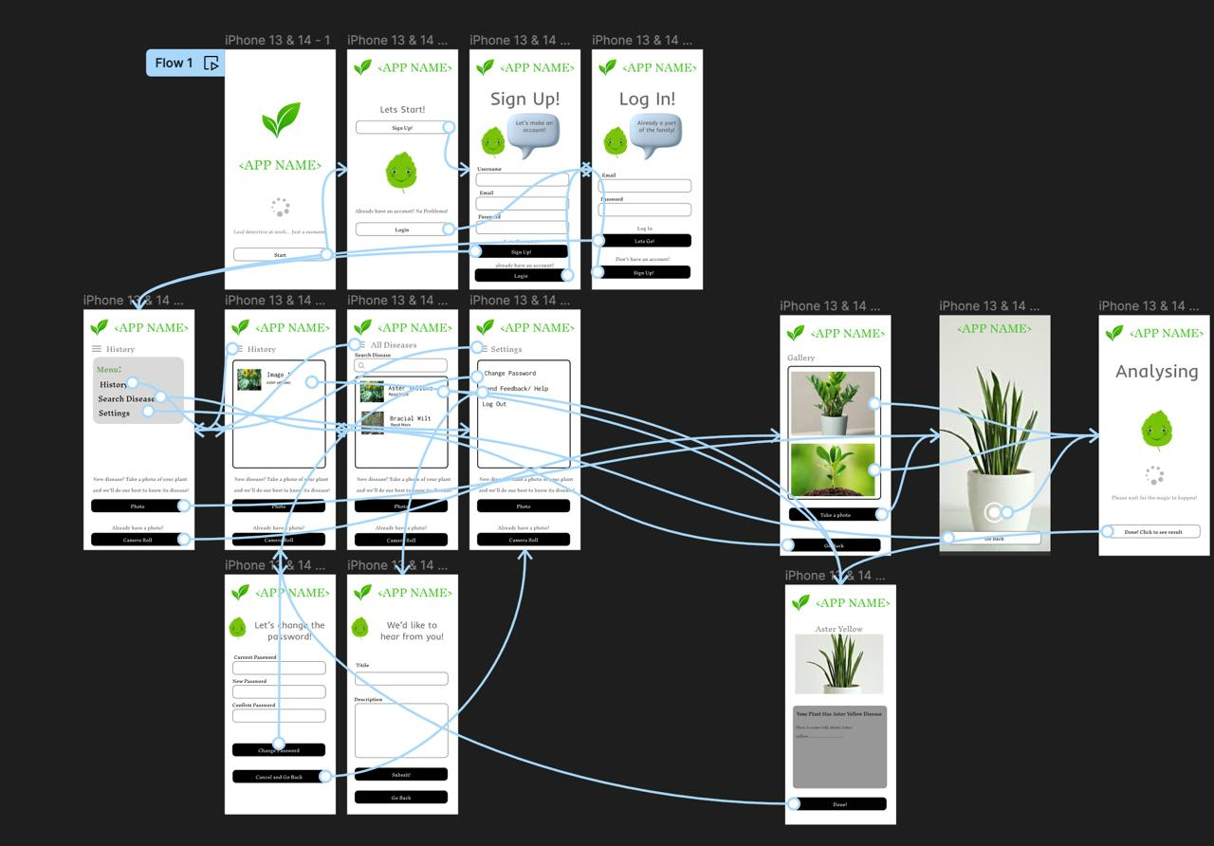
UI DESIGN GENERALISED

Slide 11
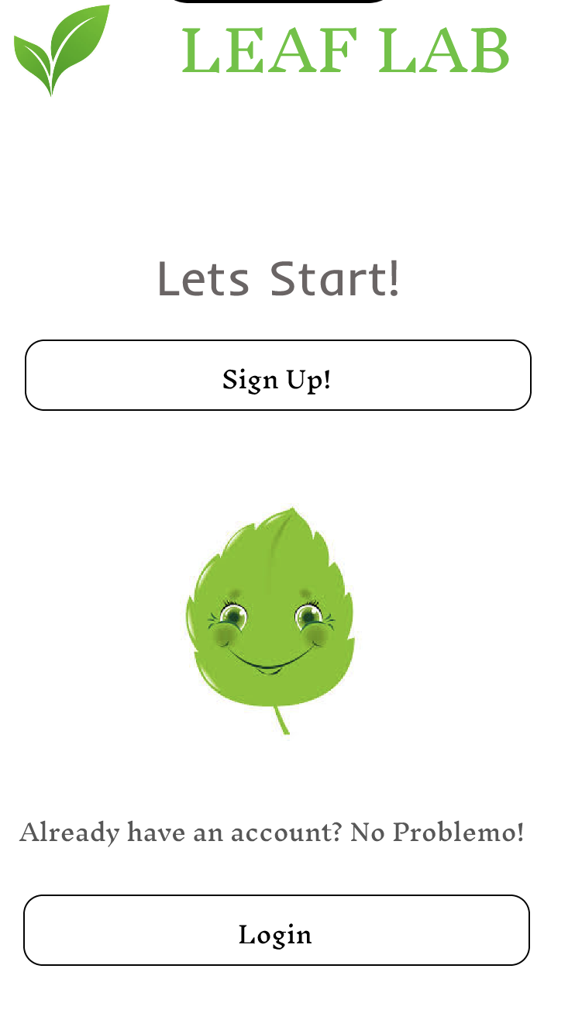
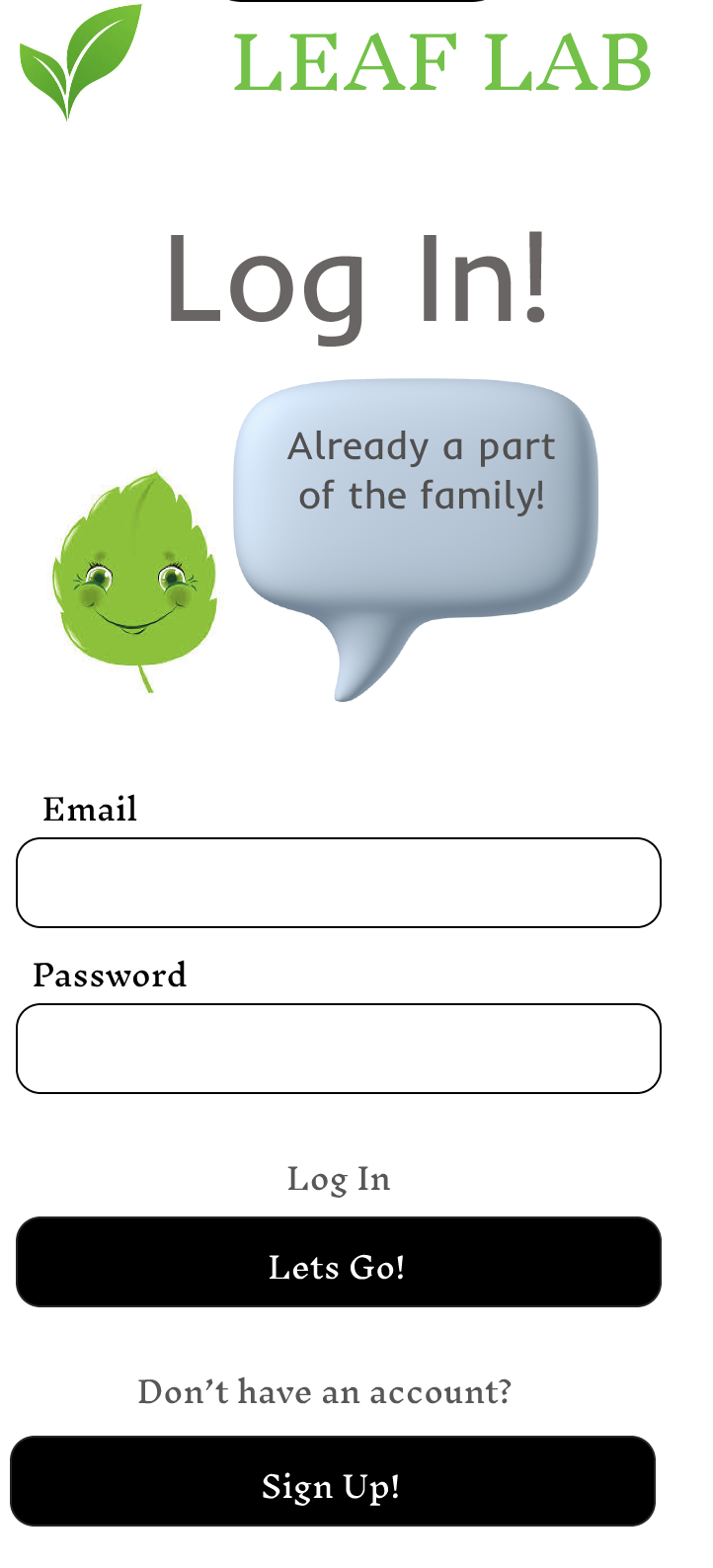
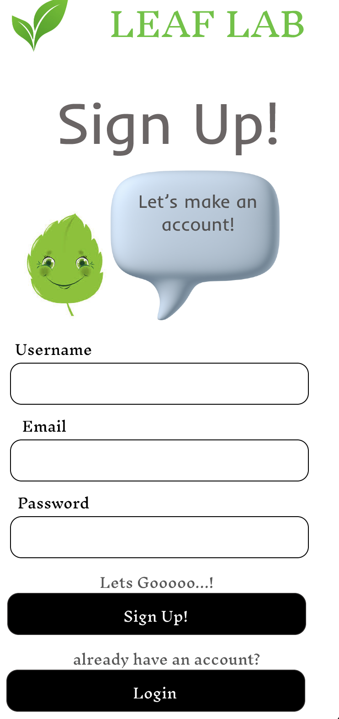
UI DESIGN

Slide 12
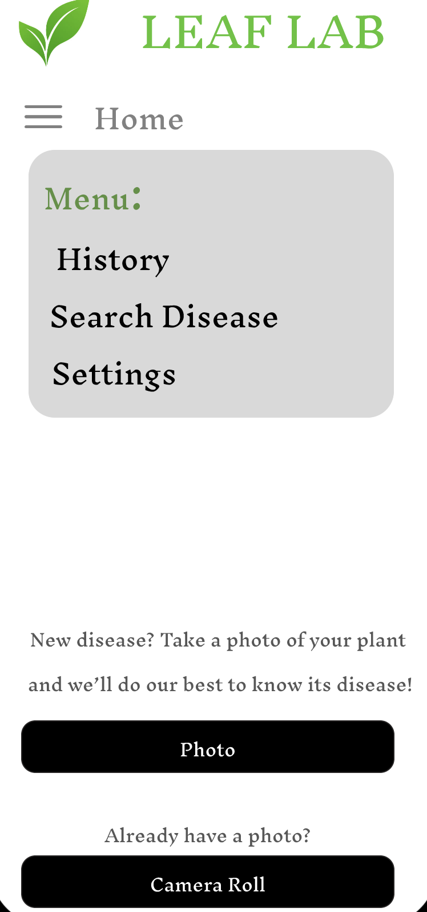
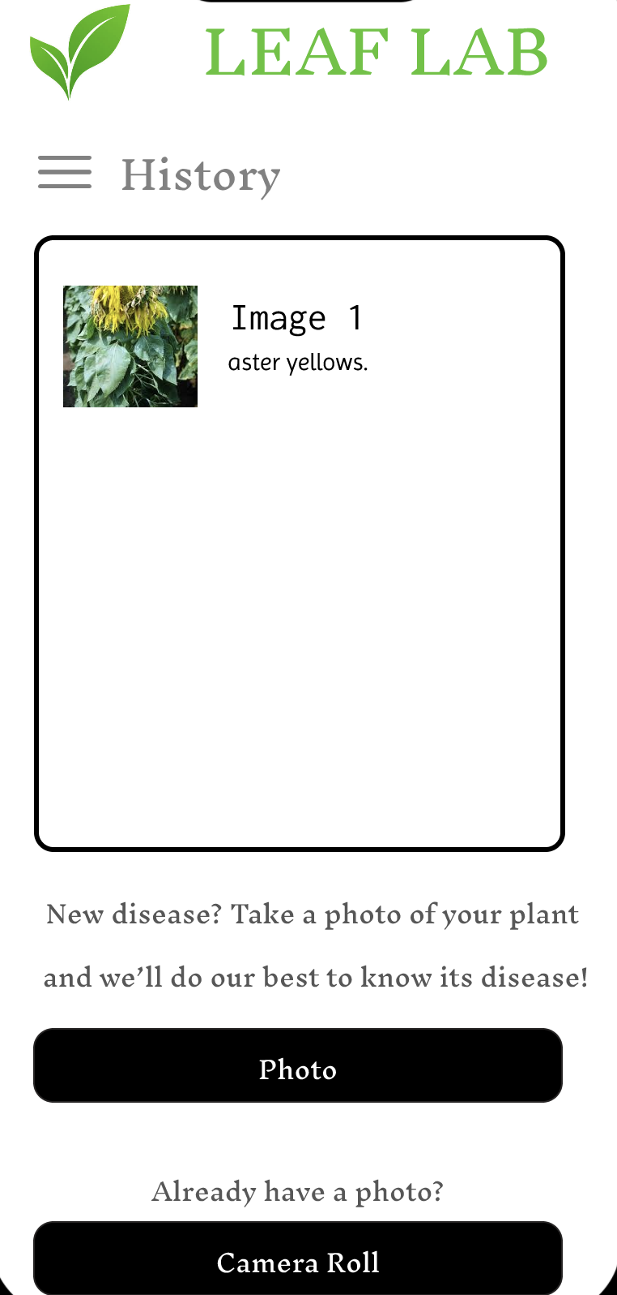
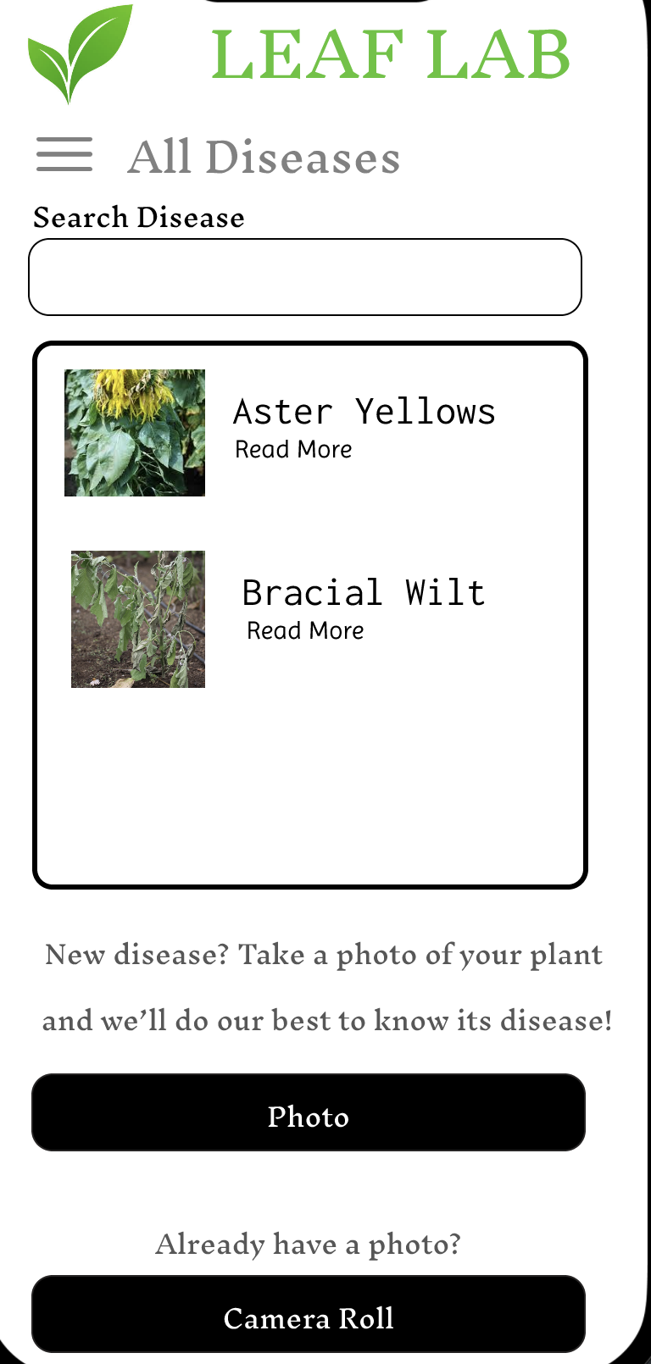
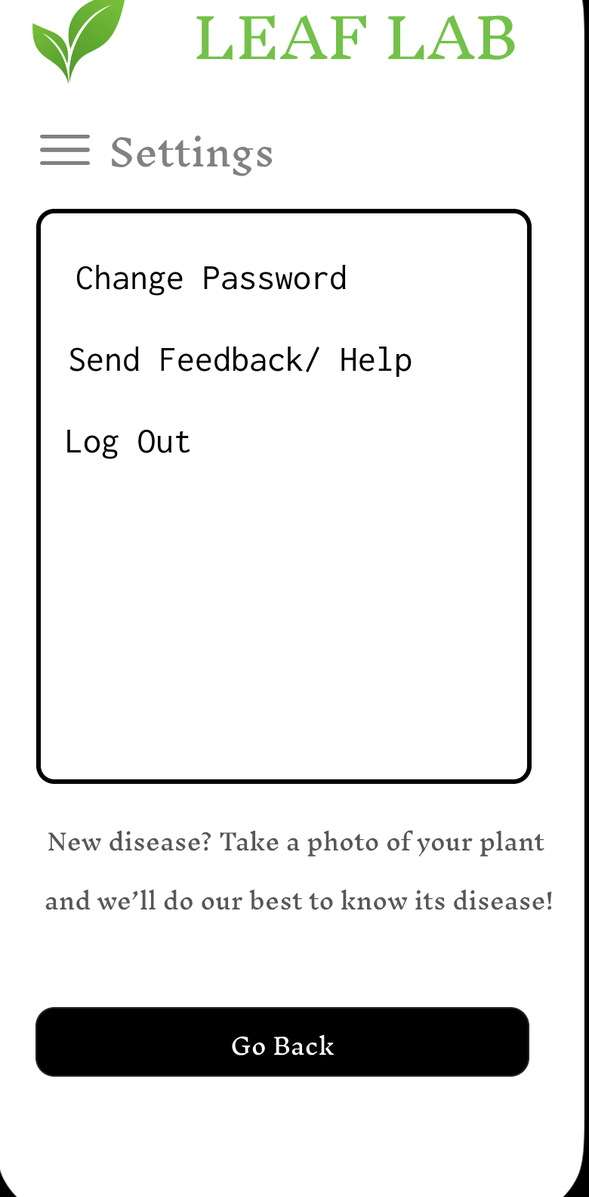
UI DESIGN

Slide 13
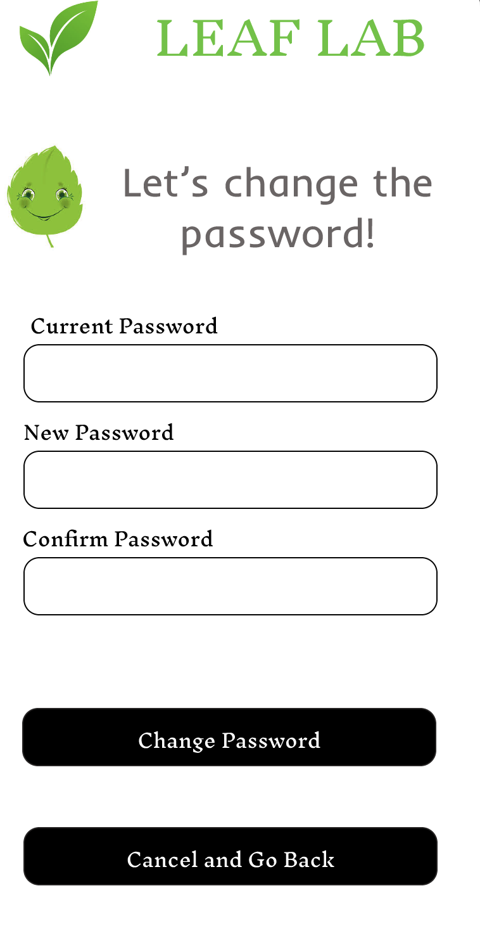
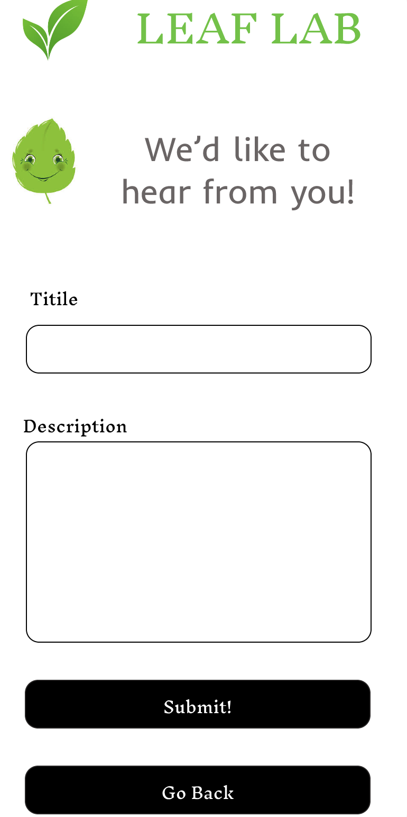
UI DESIGN

Slide 14
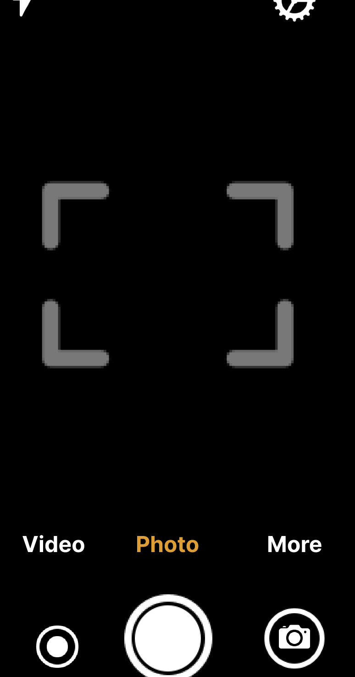
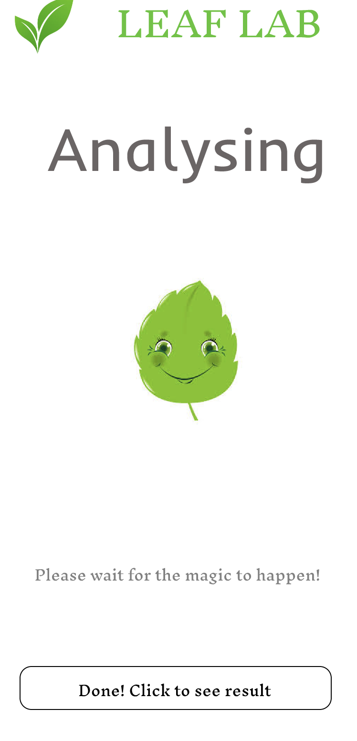
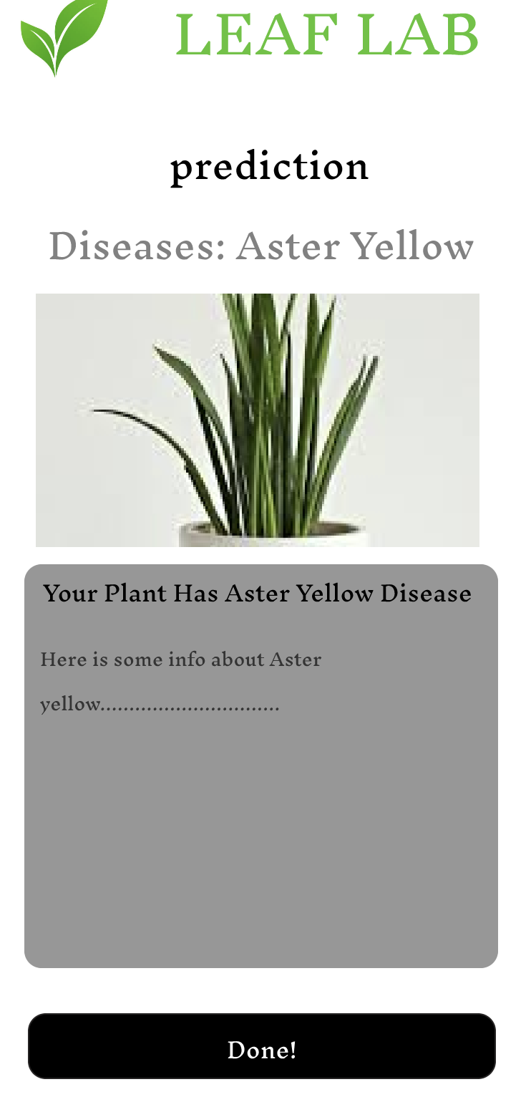
UI DESIGN

Slide 15
APP DEVELOPMENT
Types of Frontend:
UI
Model
Camera
Gallery
Types of backend services:
Firebase

Slide 16
TESTING METHODS
We will release a beta version for the application for users to test. We will also use a security team to help testing for vulnerabilities and how to prevent it. Lastly Functional testing to test all functions that are capable and suitable to work for this app

Slide 17


DEPLOYMENT:
App Store
Play Store

Slide 18
Analysis
This application will be used across the world for users that may encounter an issue with plants or leaves with a disease that maybe unknown to the user.

Slide 19
Conclusion
With the vast improvement of AI in the last few years, luckily, we were able to implement an app that is able to detect diseases from just a photo!

Slide 20
REFERENCES
https://www.ibm.com/topics/mobile-application-development
https://en.wikipedia.org/wiki/Mobile_app_development
https://developer.android.com/

Slide 21
Thank You

